Slide 1
Amplify-and-Forward Relay-Aided Covert Communications With Artificial Noise
Aug. 26, 2024
Jihwan Moon

Slide 2
Table of Contents
1. Introduction
2. System model
3. Problem formulation
4. Proposed solutions
5. Numerical results

Slide 3
1. Introduction

Slide 4
2. System model

Slide 5











2. System model
2.1 Schematic diagram
Covert message detector
Public message, x_{P}
Source
S
AF Relay
R
Destination
D
Covert message, x_{C}
Artificial
noise, x_{J}

Slide 6

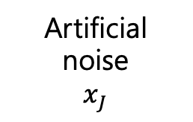
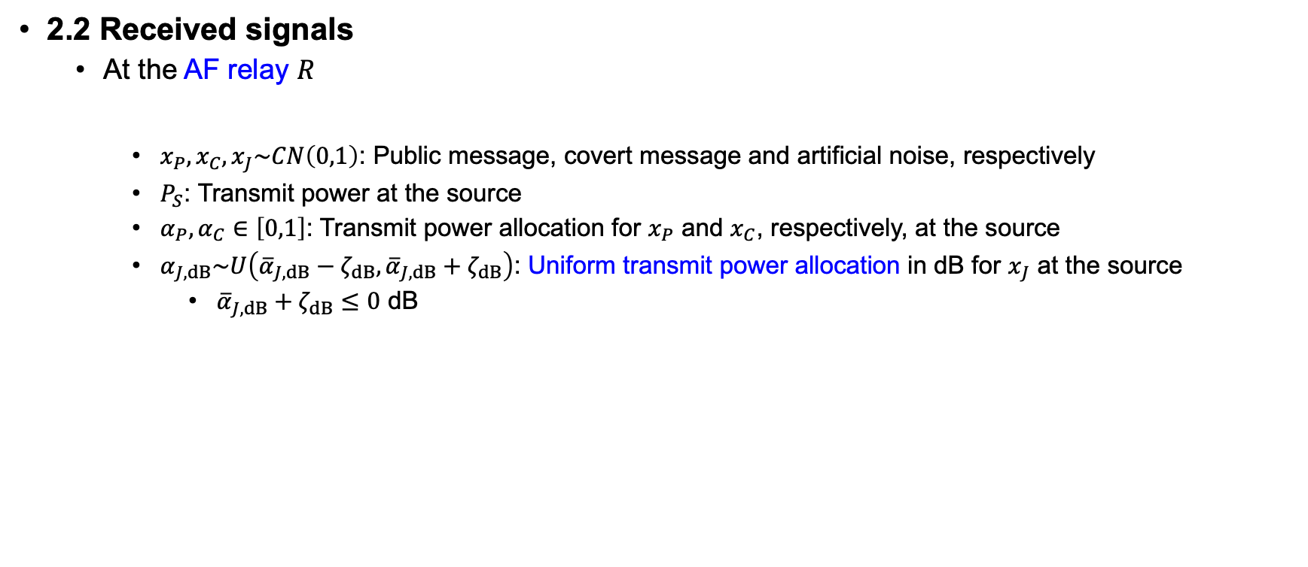

2. System model
2.2 Received signals
At the AF relay $R$
$x_{P},x_{C},x_{J}\sim CN\left(0,1\right)$: Public message, covert message and artificial noise, respectively
$P_{S}$: Transmit power at the source
$α_{P},α_{C}∈\left[0,1\right]$: Transmit power allocation for $x_{P}$ and $x_{C}$, respectively, at the source
$α_{J,dB}\sim U\left({\overline{α}}_{J,dB}−ζ_{dB},{\overline{α}}_{J,dB}+ζ_{dB}\right)$: Uniform transmit power allocation in dB for $x_{J}$ at the source
${\overline{α}}_{J,dB}+ζ_{dB}≤0$ dB
Public message, $x_{P}$
Source
S
AF relay
R
Covert
message
$$x_{C}$$
Artificial
noise
$$x_{J}$$

Slide 7

2. System model
2.2 Received signals
At the destination $D$
AF relay
R
Destination
D

Slide 8

2. System model
2.2 Received signals
At the destination $D$
Achievable rate for the public message by treating the covert message as interference

Slide 9

2. System model
2.2 Received signals
At the destination $D$
Achievable rate for the covert message after canceling the decoded public message and artificial noise by cooperation between $S$ and $D$ to have ${\tilde{y}}_{D}$
Cancellable by cooperation between $S$ and $D$

Slide 10
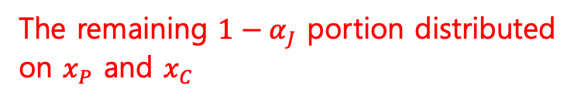
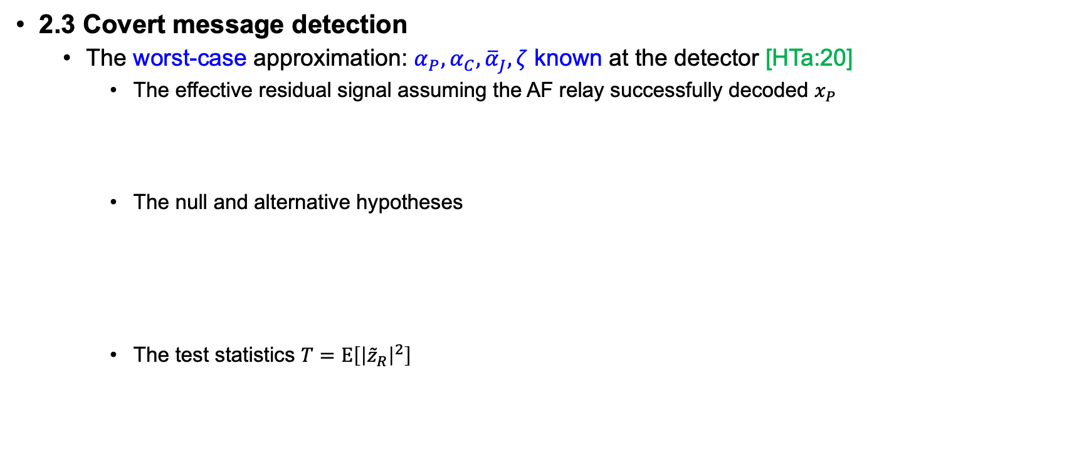
2. System model
2.3 Covert message detection
The worst-case approximation: $α_{P},α_{C},{\overline{α}}_{J},ζ$ known at the detector [HTa:20]
The effective residual signal assuming the AF relay successfully decoded $x_{P}$
The null and alternative hypotheses
The test statistics $T=E\left[{\left|{\tilde{z}}_{R}\right|}^{2}\right]$
All the remaining $1−α_{J}$ portion allocated on $x_{P}$
The remaining $1−α_{J}$ portion distributed
on $x_{P}$ and $x_{C}$

Slide 11
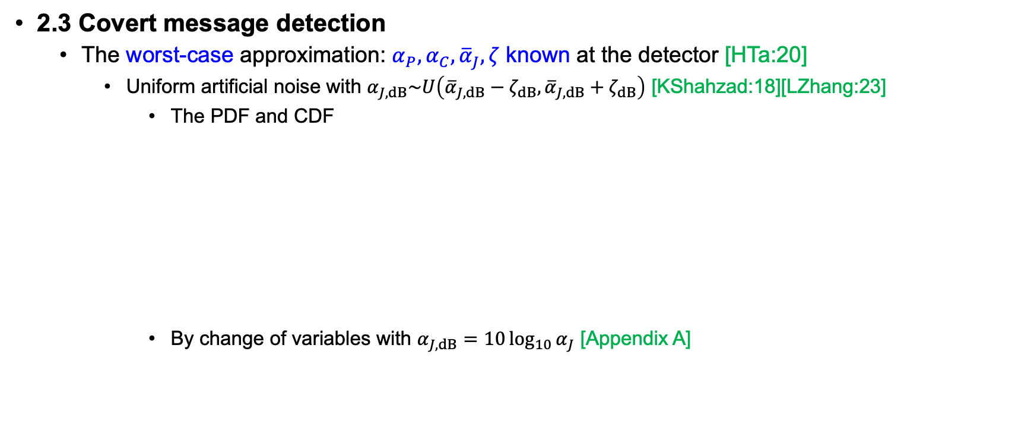
2. System model
2.3 Covert message detection
The worst-case approximation: $α_{P},α_{C},{\overline{α}}_{J},ζ$ known at the detector [HTa:20]
Uniform artificial noise with $α_{J,dB}\sim U\left({\overline{α}}_{J,dB}−ζ_{dB},{\overline{α}}_{J,dB}+ζ_{dB}\right)$ [KShahzad:18][LZhang:23]
The PDF and CDF
By change of variables with $α_{J,dB}=10\log_{10}{α_{J}}$ [Appendix A]

Slide 12

2. System model
2.3 Covert message detection
The worst-case approximation: $α_{P},α_{C},{\overline{α}}_{J},ζ$ known at the detector [HTa:20]
Decision based on a threshold $τ$
Detection error probability (DEP)
False alarm probability

Slide 13

2. System model
2.3 Covert message detection
The worst-case approximation: $α_{P},α_{C},{\overline{α}}_{J},ζ$ known at the detector [HTa:20]
Decision based on a threshold $τ$
Detection error probability (DEP)
Miss probability

Slide 14

2. System model
2.3 Covert message detection
The worst-case approximation: $α_{P},α_{C},{\overline{α}}_{J},ζ$ known at the detector [HTa:20]
Decision based on a threshold $τ$
Detection error probability (DEP)
Assuming the equally probable chance of the covert message, $\operatorname{Pr}\left(H_{0}\right)=\operatorname{Pr}\left(H_{1}\right)=\frac{1}{2}$

Slide 15
2. System model
2.3 Covert message detection
The worst-case approximation: $α_{P},α_{C},{\overline{α}}_{J},ζ$ known at the detector [HTa:20]
Decision based on a threshold $τ$
Detection error probability (DEP)
Assuming the equally probable chance of the covert message, $\operatorname{Pr}\left(H_{0}\right)=\operatorname{Pr}\left(H_{1}\right)=\frac{1}{2}$

Slide 16
2. System model
2.3 Covert message detection
The worst-case approximation: $α_{P},α_{C},{\overline{α}}_{J},ζ$ known at the detector [HTa:20]
Decision based on a threshold $τ$
Detection error probability (DEP)
Assuming the equally probable chance of the covert message, $\operatorname{Pr}\left(H_{0}\right)=\operatorname{Pr}\left(H_{1}\right)=\frac{1}{2}$

Slide 17

2. System model
2.3 Covert message detection
The worst-case approximation: $α_{P},α_{C},{\overline{α}}_{J},ζ$ known at the detector [HTa:20]
The shape of the DEP function
Maximum error
= A random guess

Slide 18

2. System model
2.3 Covert message detection
The worst-case approximation: $α_{P},α_{C},{\overline{α}}_{J},ζ$ known at the detector [HTa:20]
The shape of the DEP function
Note that

Slide 19

2. System model
2.3 Covert message detection
The worst-case approximation: $α_{P},α_{C},{\overline{α}}_{J},ζ$ known at the detector [HTa:20]
The shape of the DEP function
The first derivative
Note that

Slide 20

2. System model
2.3 Covert message detection
The worst-case approximation: $α_{P},α_{C},{\overline{α}}_{J},ζ$ known at the detector [HTa:20]
The shape of the DEP function
Since

Slide 21
2. System model
2.3 Covert message detection
The worst-case approximation: $α_{P},α_{C},{\overline{α}}_{J},ζ$ known at the detector [HTa:20]
The shape of the DEP function
Maximum error
= A random guess

Slide 22

2. System model
2.3 Covert message detection
The worst-case approximation: $α_{P},α_{C},{\overline{α}}_{J},ζ$ known at the detector [HTa:20]
The minimum DEP and the optimal threshold $τ^{⋆}$

Slide 23
3. Problem formulation

Slide 24
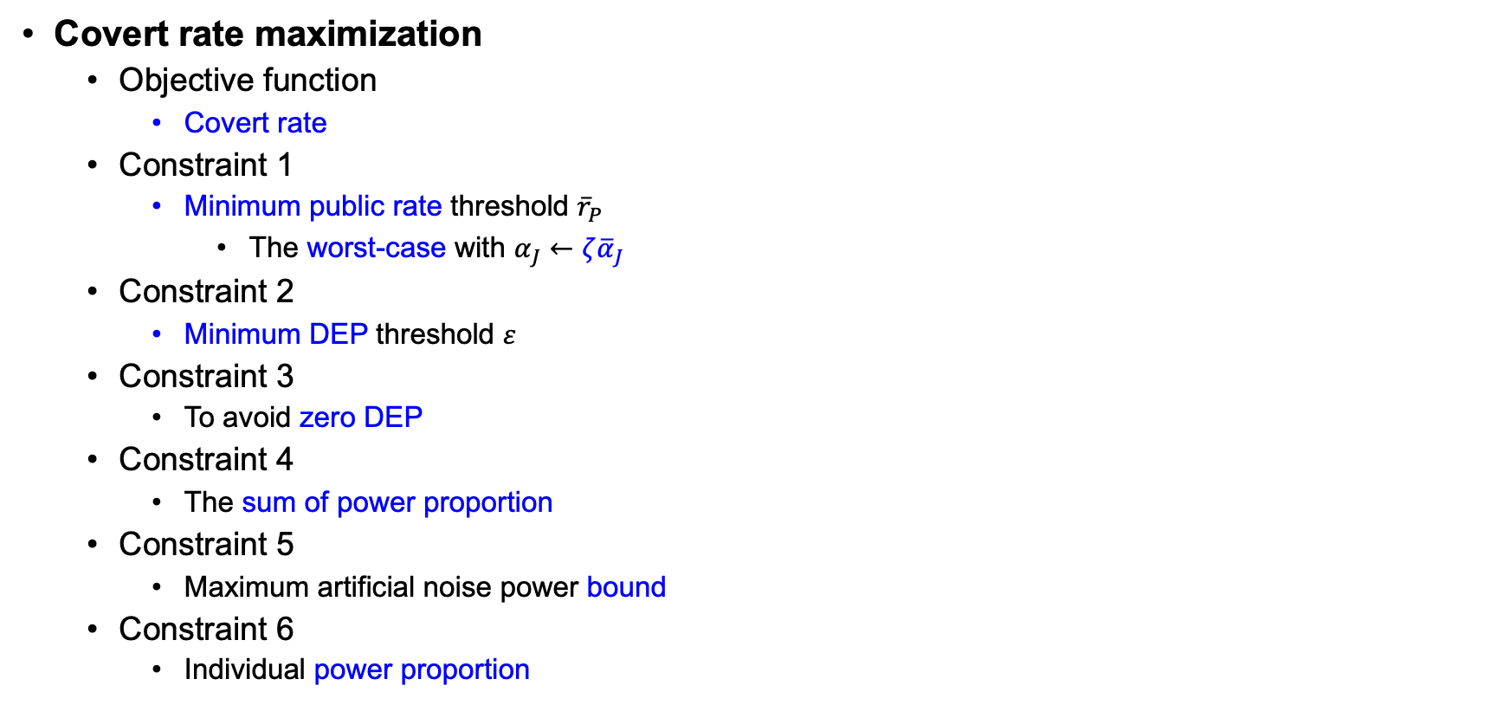
3. Problem formulation
Covert rate maximization
Objective function
Covert rate
Constraint 1
Minimum public rate threshold ${\overline{r}}_{P}$
The worst-case with $α_{J}←ζ{\overline{α}}_{J}$
Constraint 2
Minimum DEP threshold $ε$
Constraint 3
To avoid zero DEP
Constraint 4
The sum of power proportion
Constraint 5
Maximum artificial noise power bound
Constraint 6
Individual power proportion

Slide 25
5. Numerical results

Slide 26
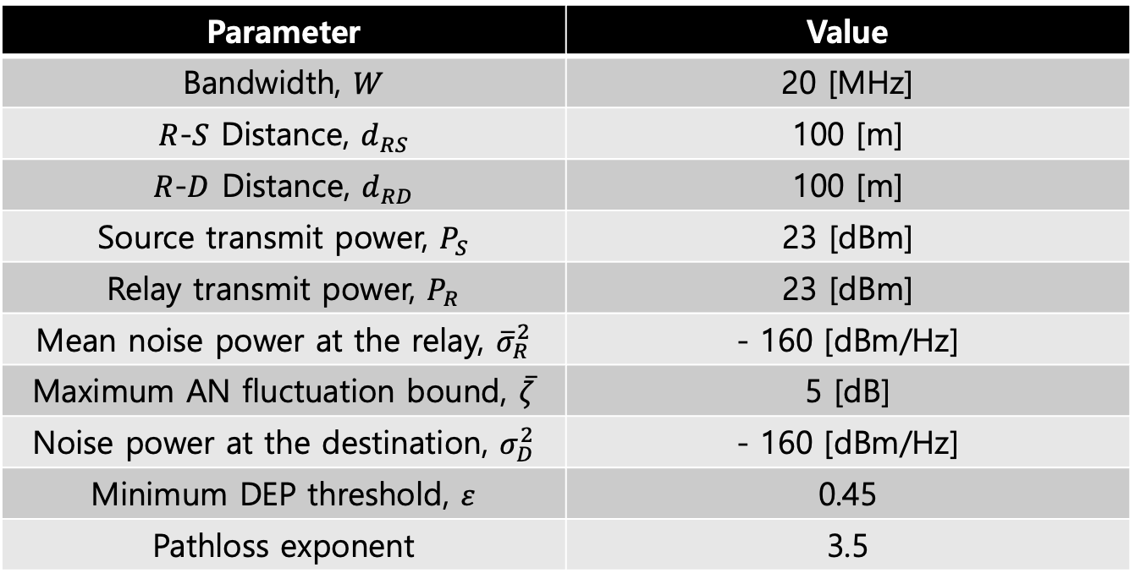
5. Numerical results
System parameter
Parameter | Value
Bandwidth, $W$ | 20 [MHz]
$R$-$S$ Distance, $d_{RS}$ | 100 [m]
$R$-$D$ Distance, $d_{RD}$ | 100 [m]
Source transmit power, $P_{S}$ | 23 [dBm]
Relay transmit power, $P_{R}$ | 23 [dBm]
Mean noise power at the relay, ${\overline{σ}}_{R}^{2}$ | - 160 [dBm/Hz]
Maximum AN fluctuation bound, $\overline{ζ}$ | 5 [dB]
Noise power at the destination, $σ_{D}^{2}$ | - 160 [dBm/Hz]
Minimum DEP threshold, $ε$ | 0.45
Pathloss exponent | 3.5

Slide 27
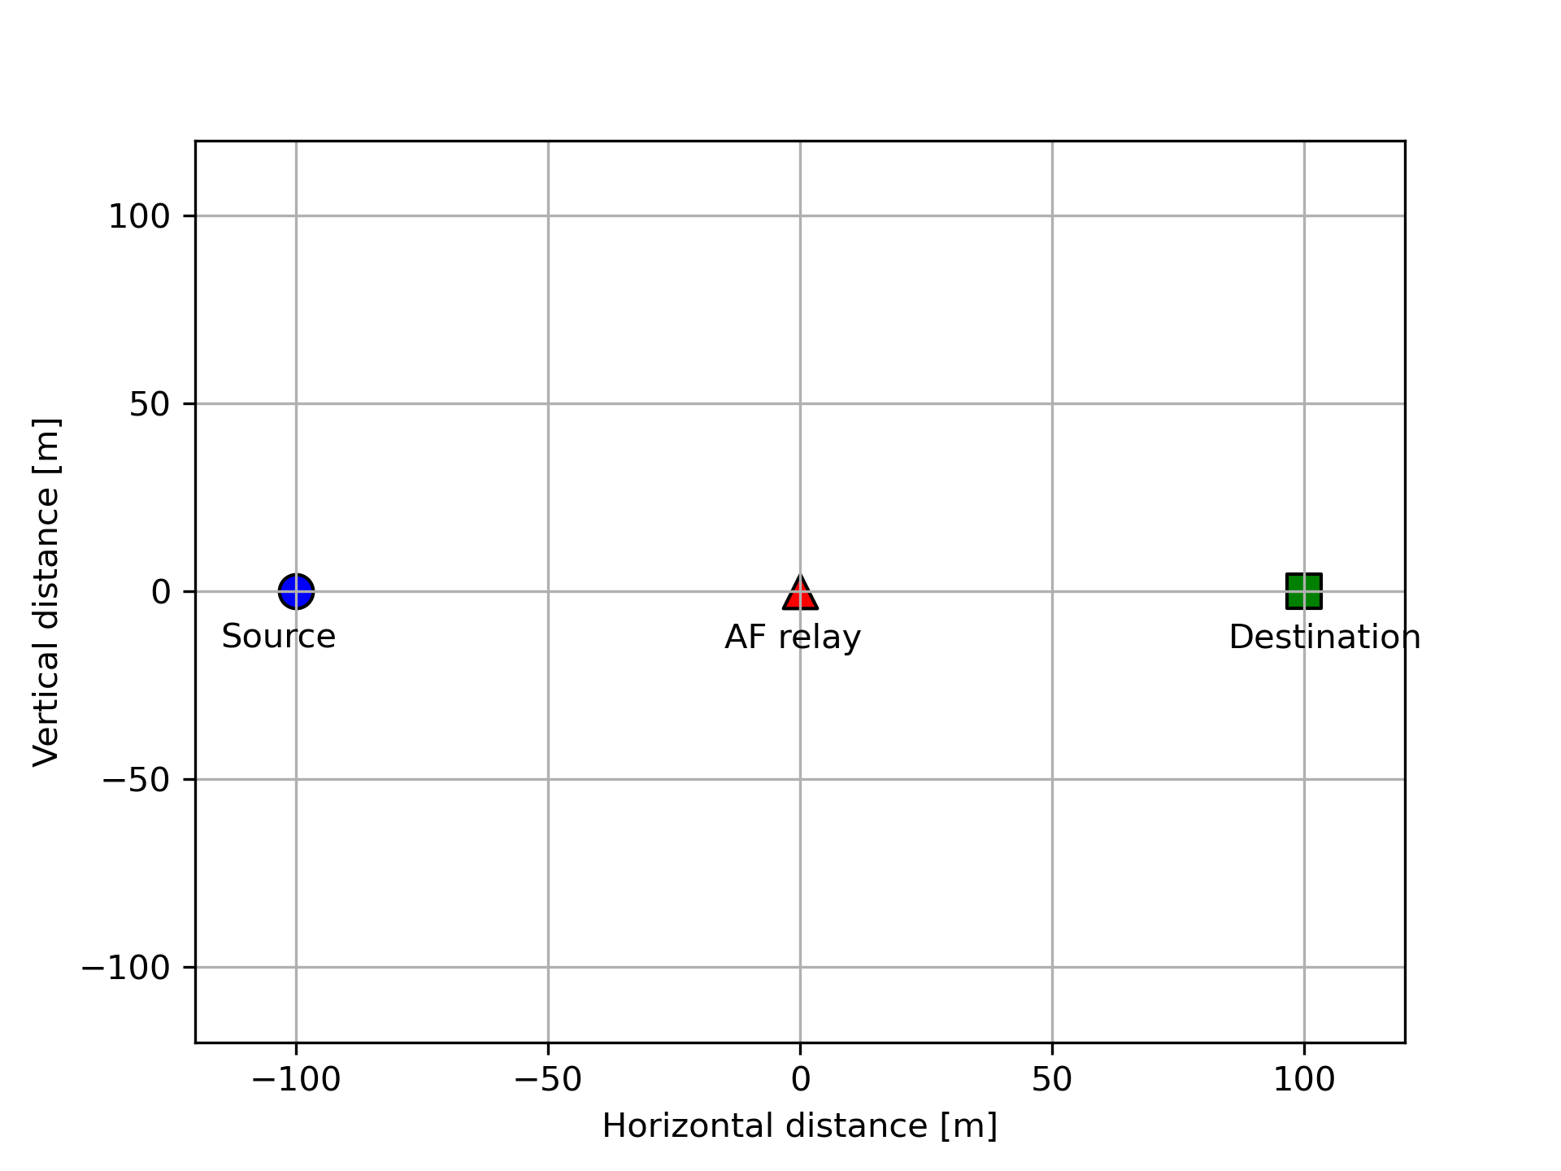
5. Numerical results
Node location

Slide 28
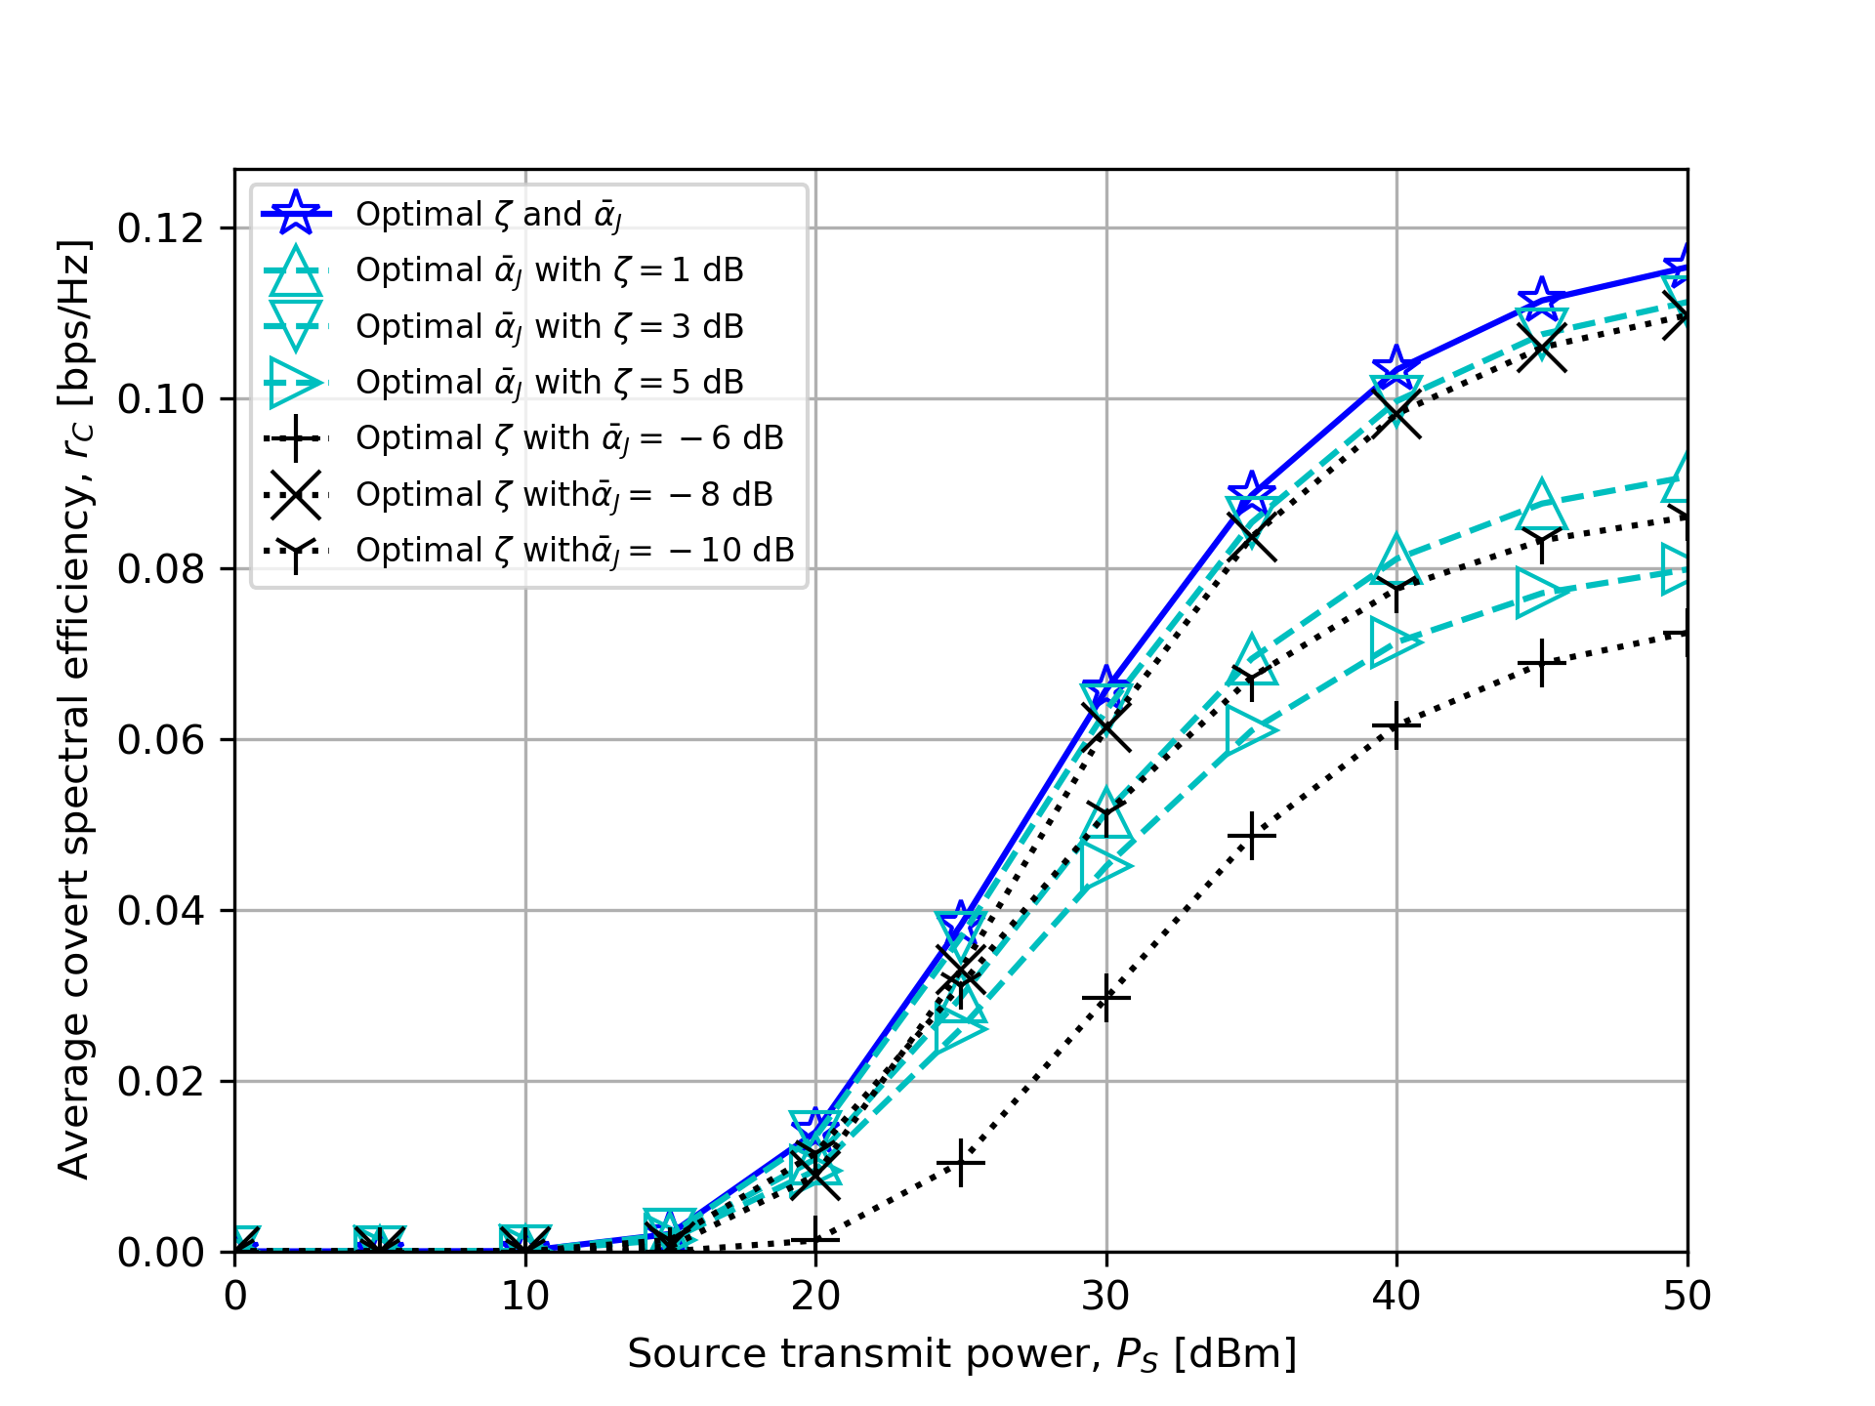
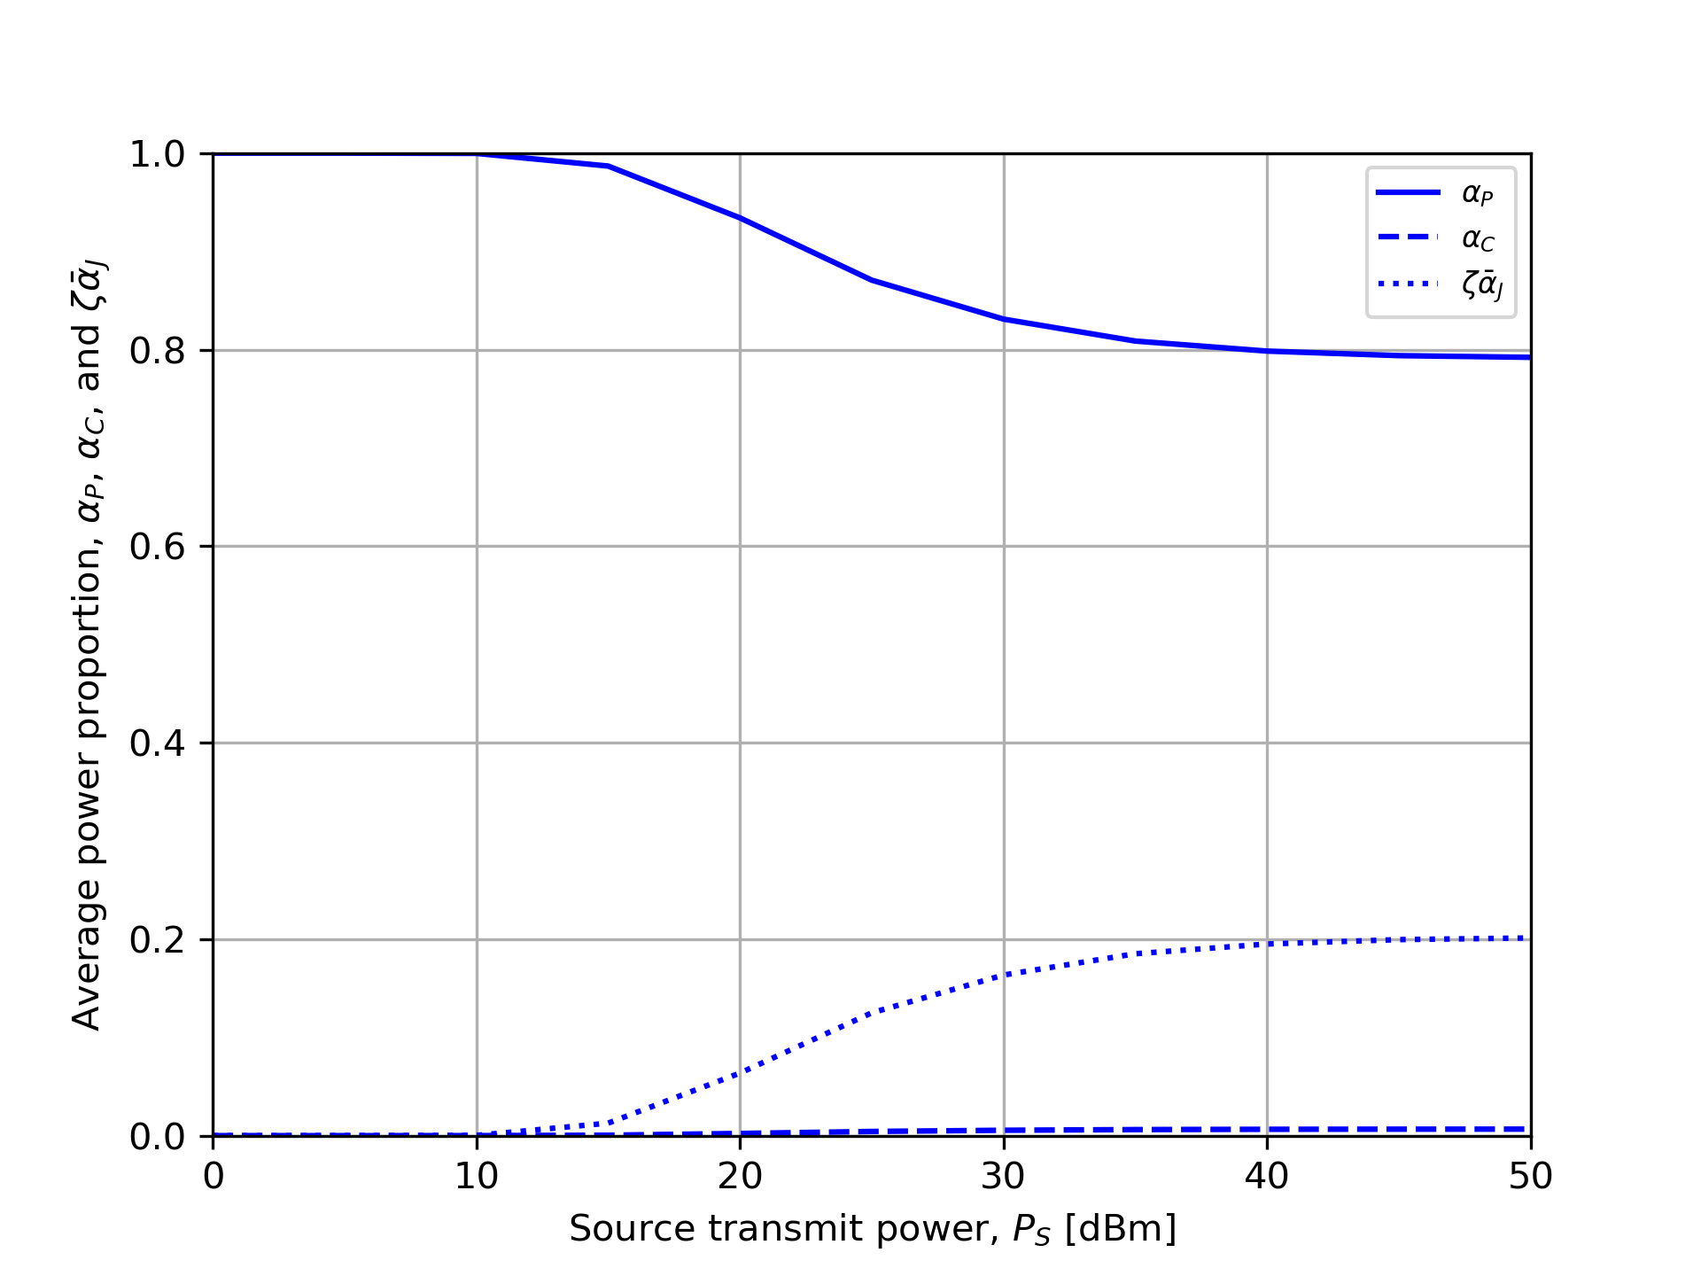

5. Numerical results
Source transmit power, $P_{S}$

Slide 29
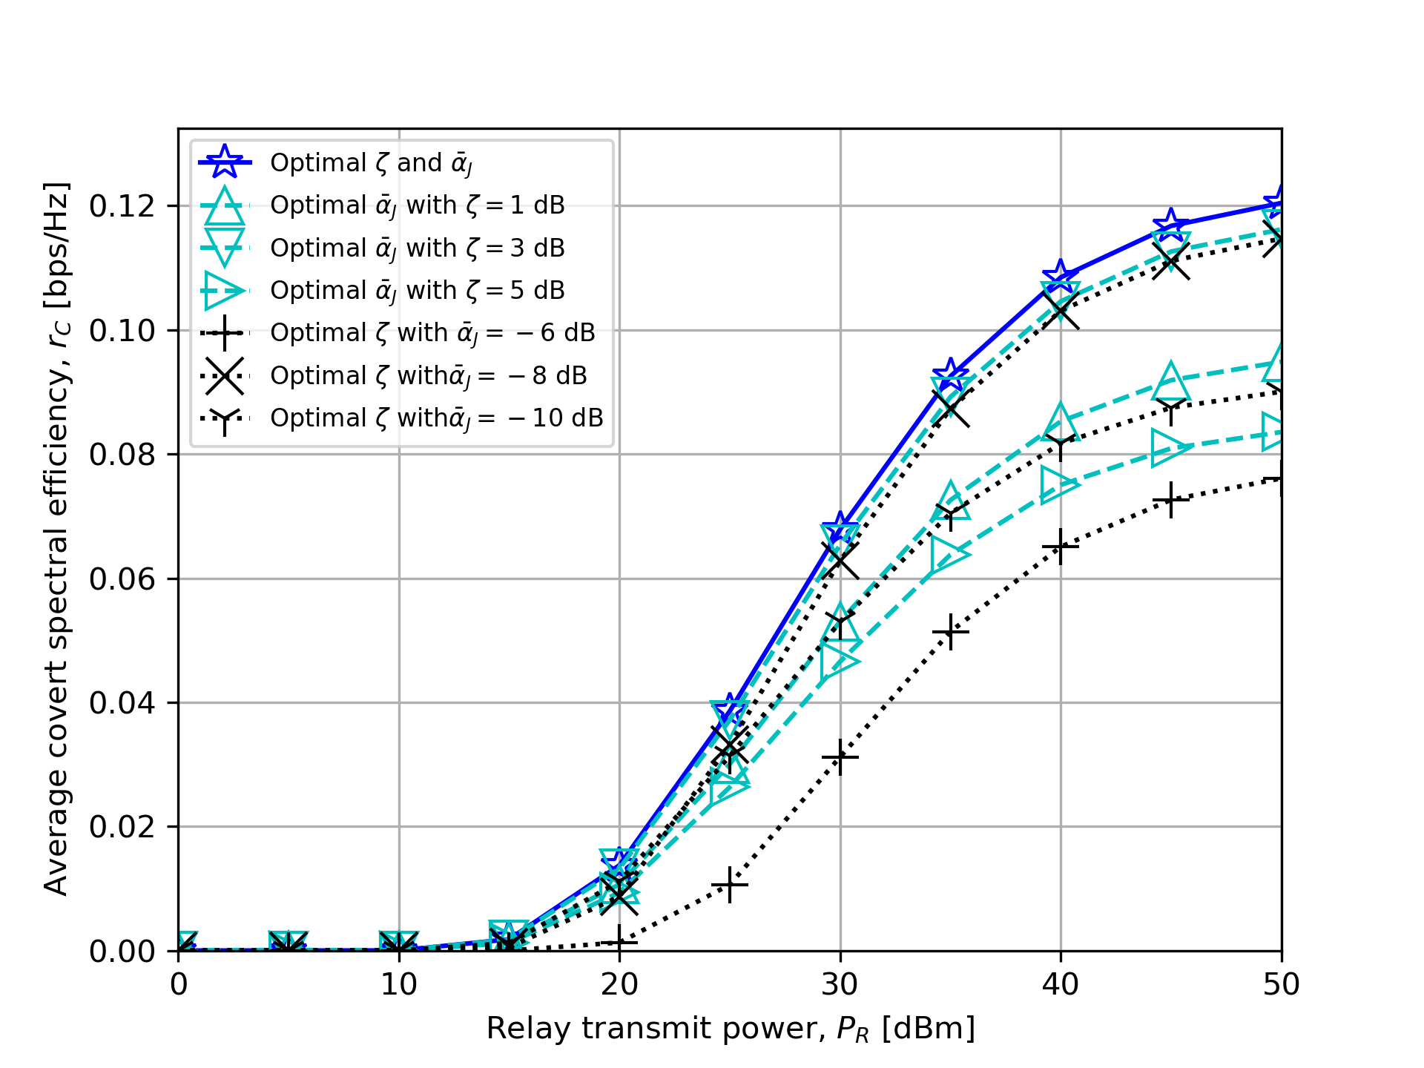
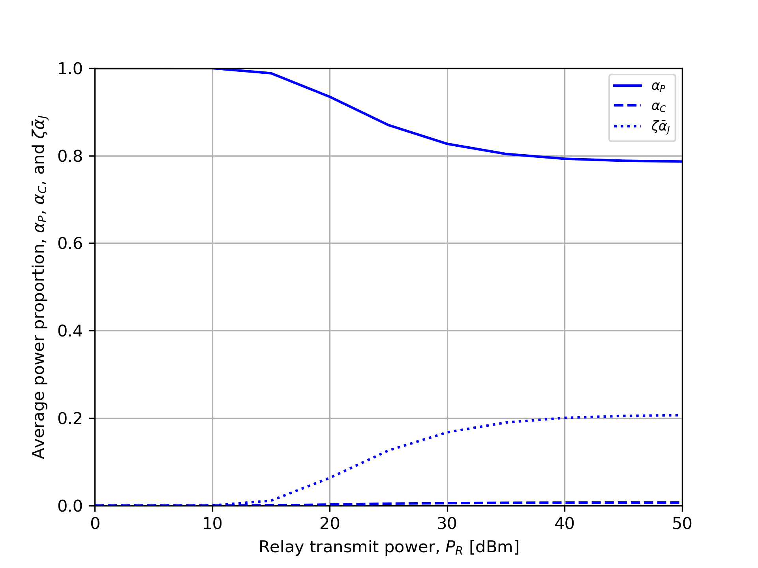

5. Numerical results
Relay transmit power, $P_{R}$

Slide 30
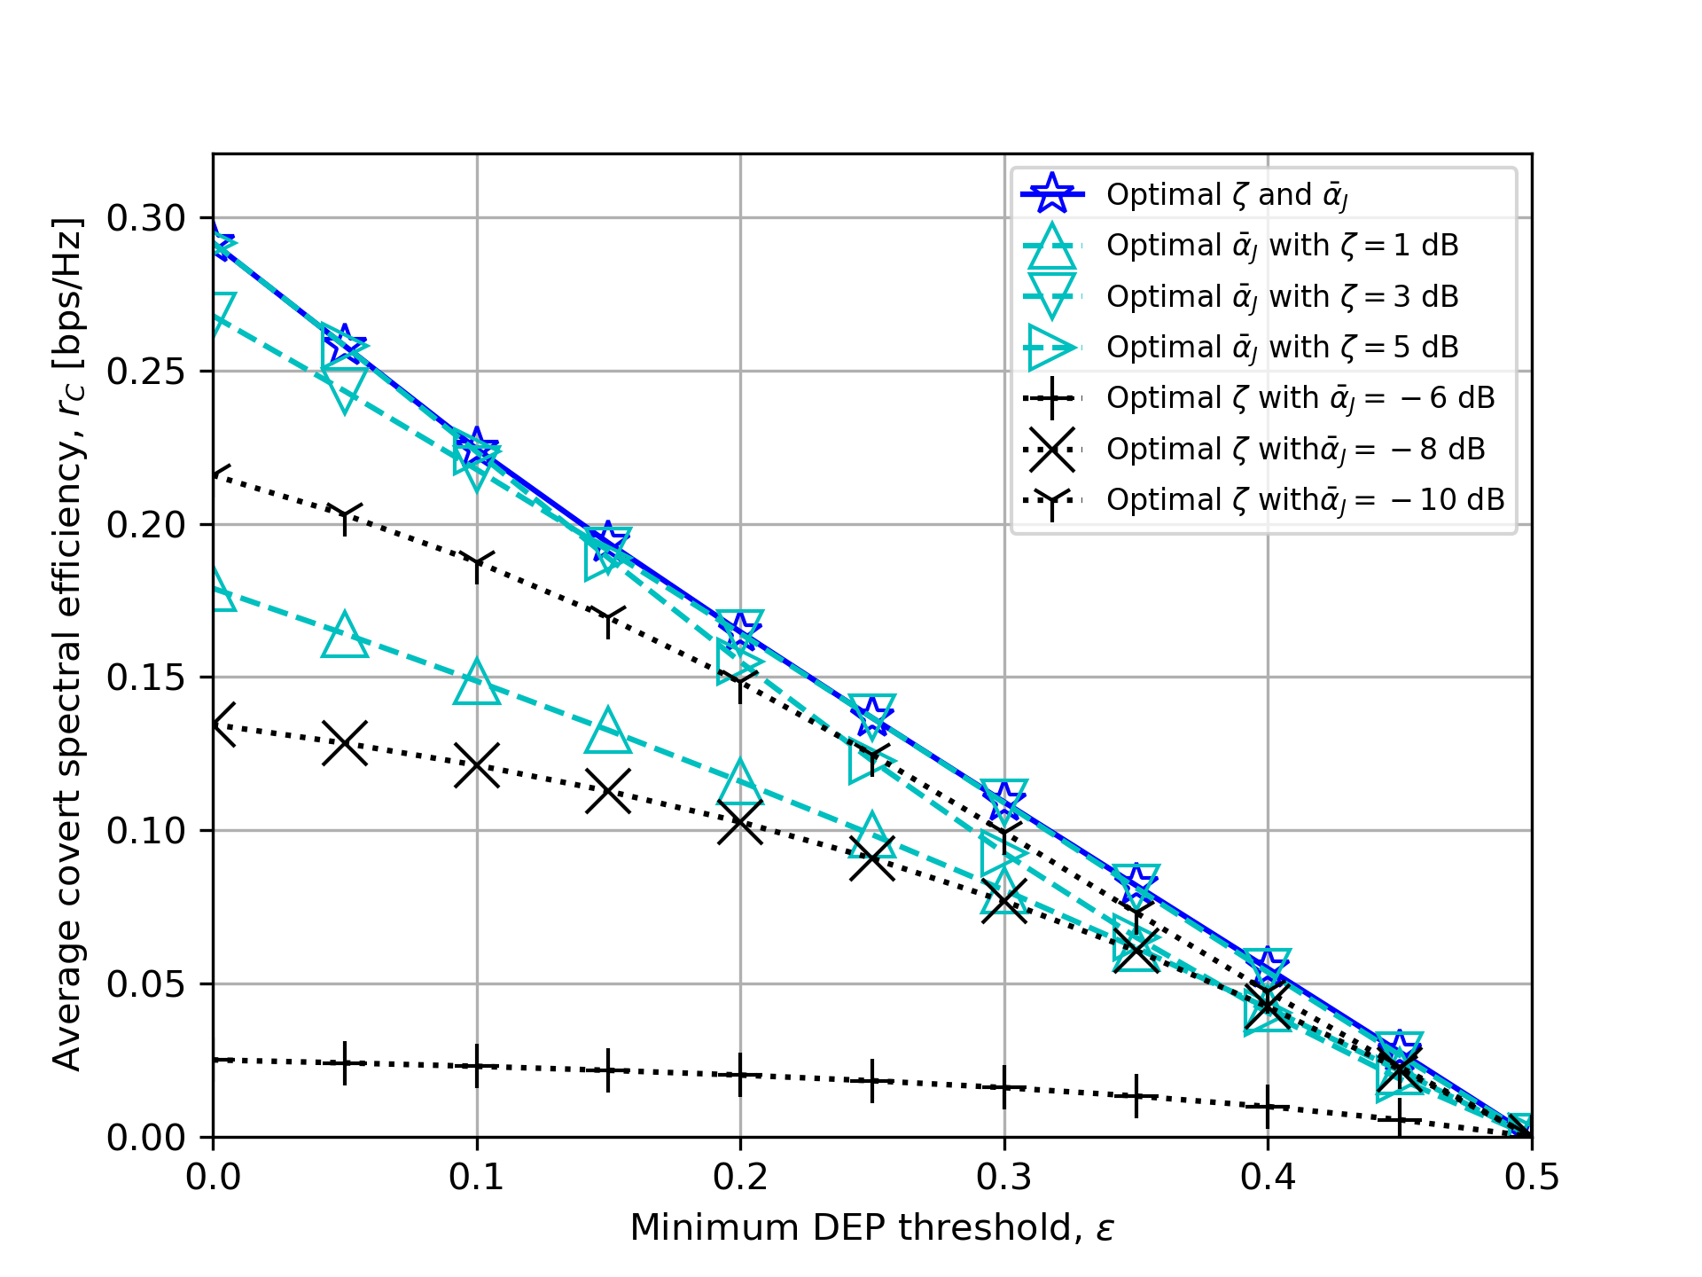
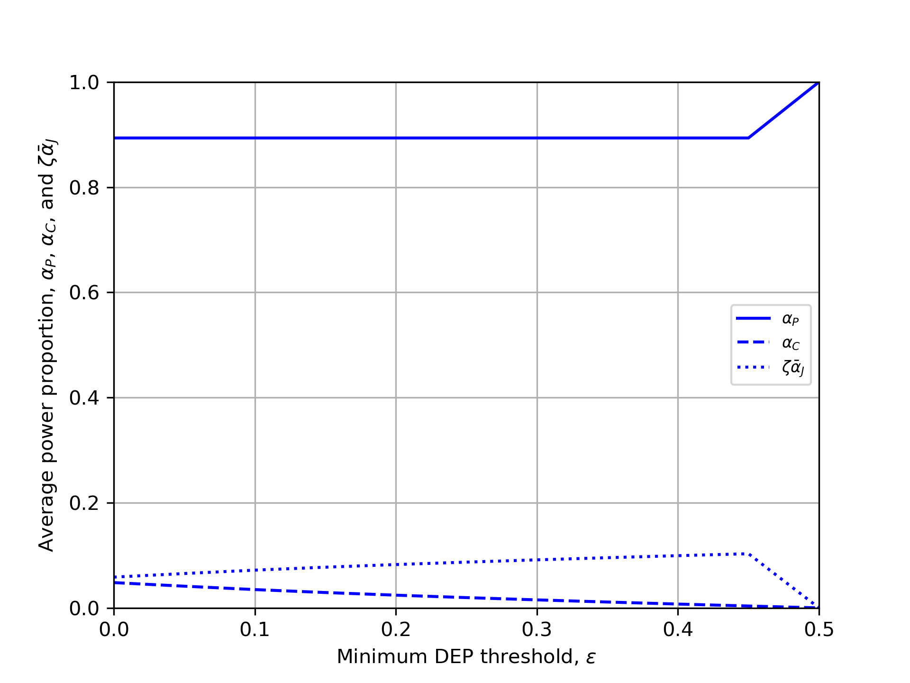

5. Numerical results
Minimum DEP threshold, $ε$

Slide 31
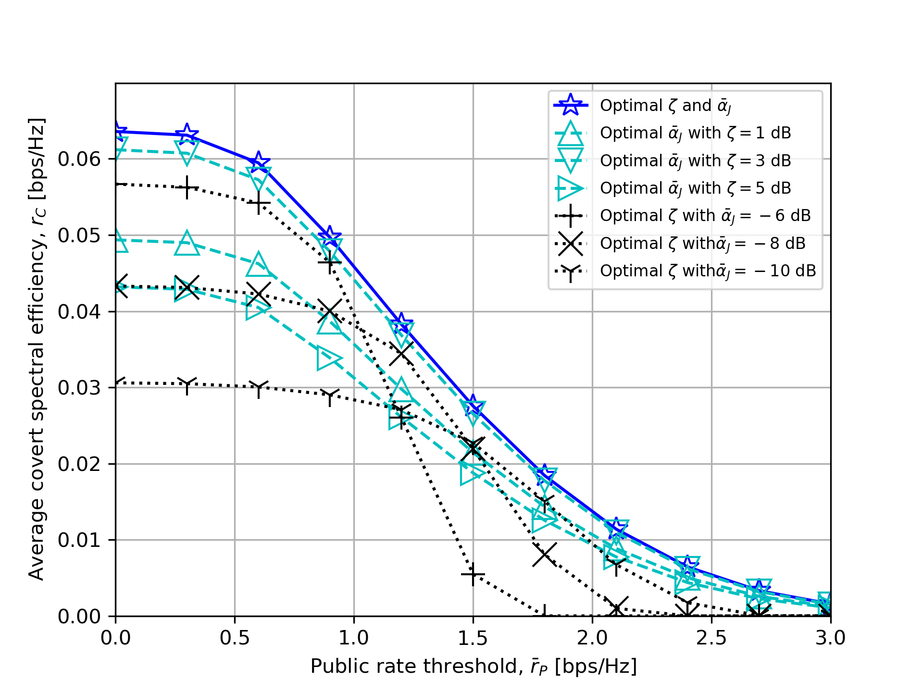
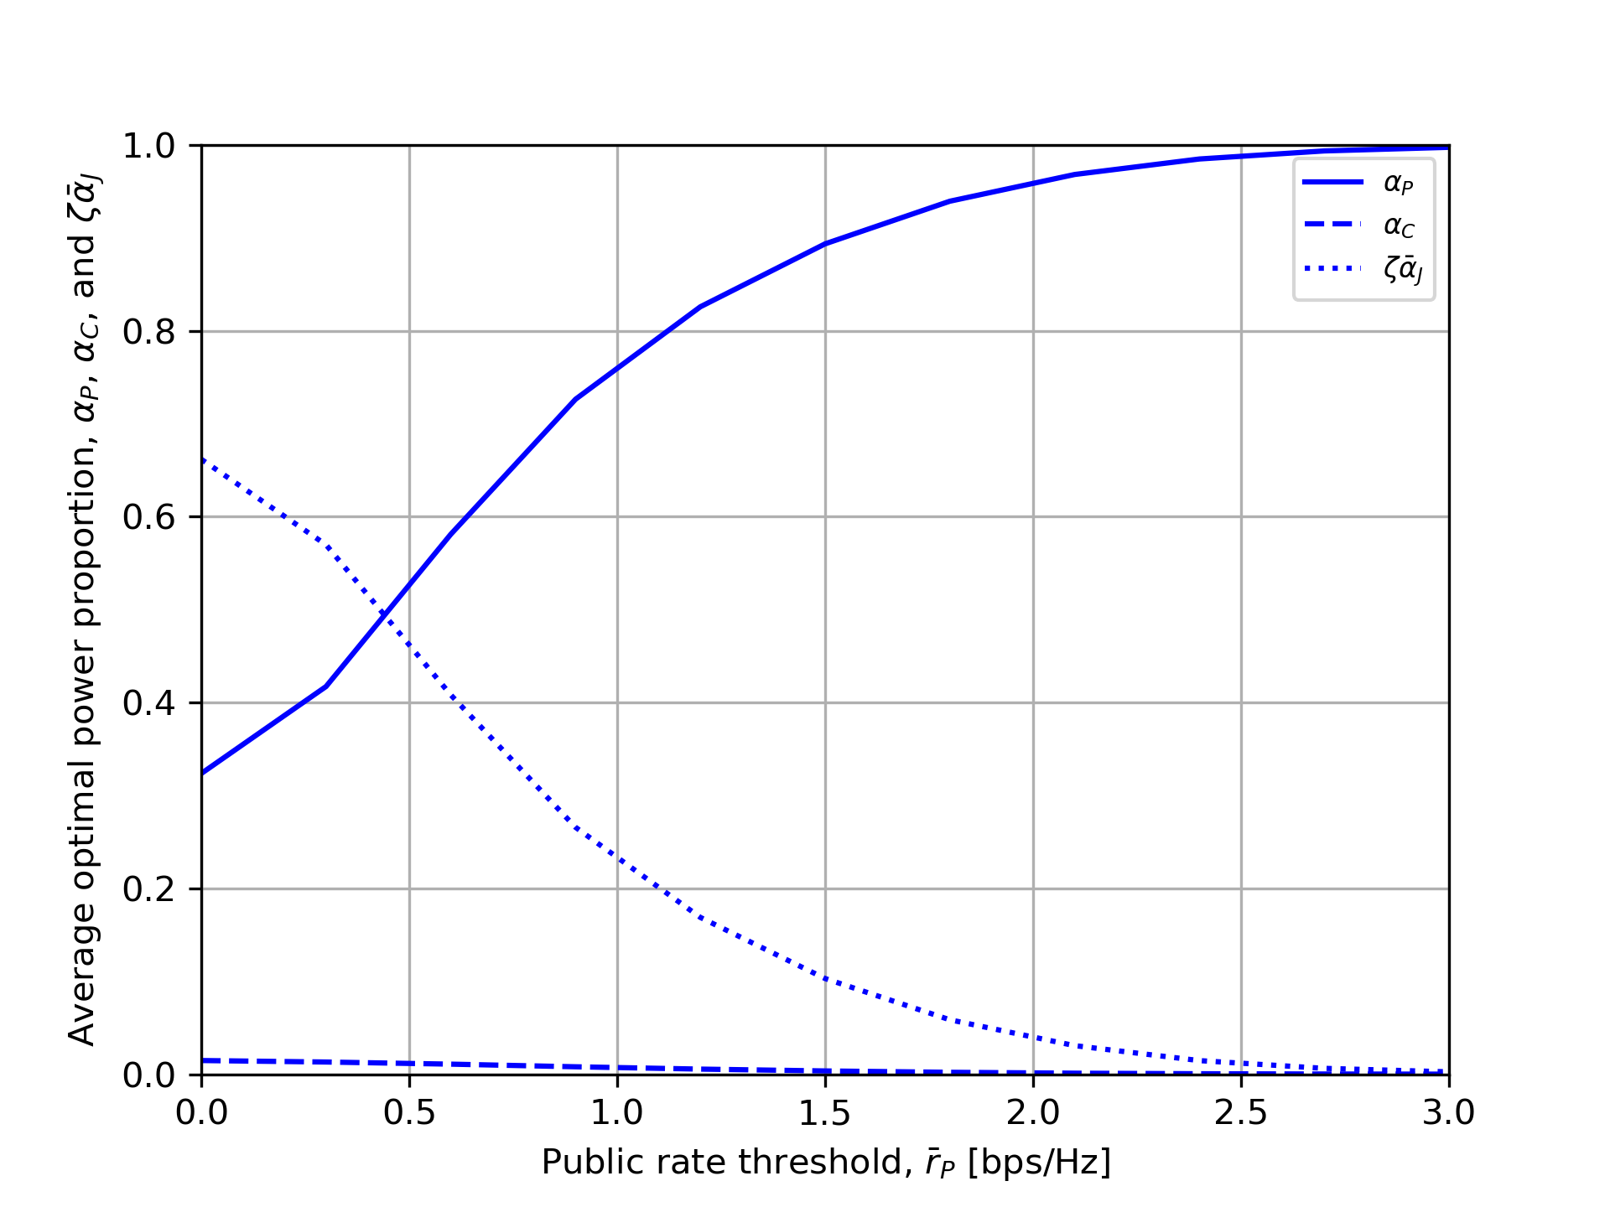

5. Numerical results
Minimum public rate threshold, ${\overline{r}}_{P}$

Slide 32
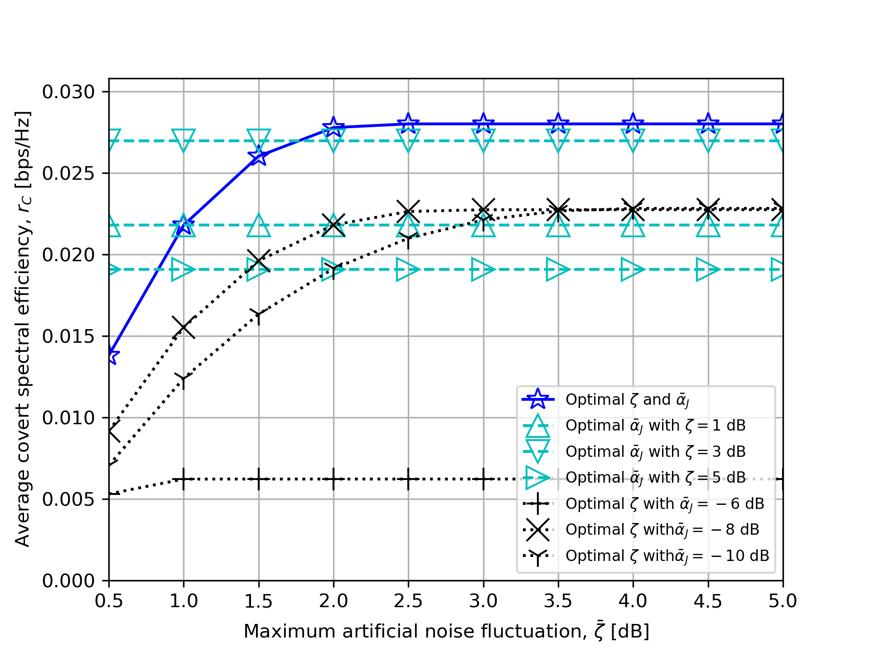
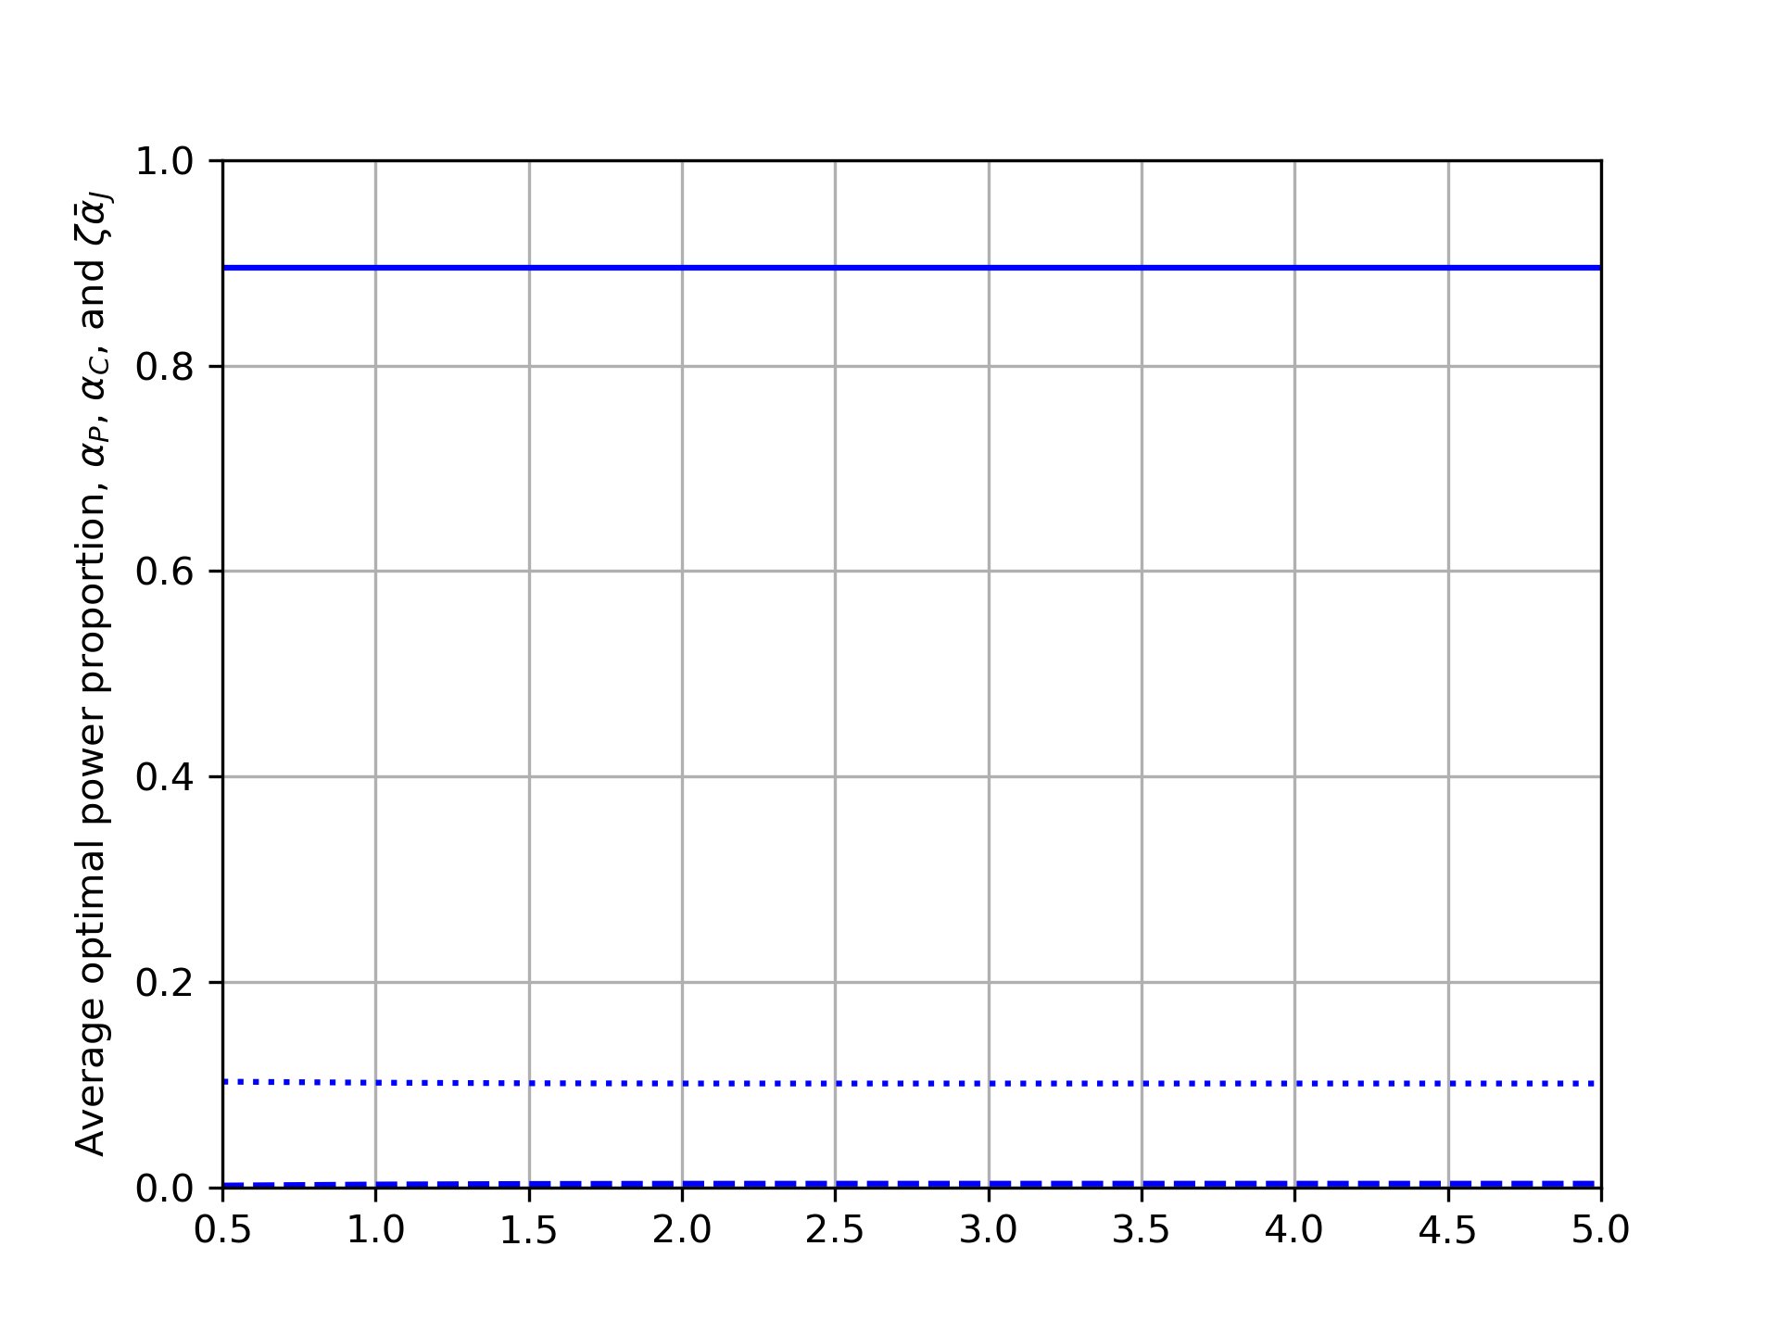

5. Numerical results
Artificial noise fluctuation bound, $\overline{ζ}$

Slide 33
Appendix A

Slide 34
Appendix A

Slide 35
References
[HTa:20] S. W. Kim and H. Q. Ta, "Covert Communications Over Multiple Overt Channels," in IEEE Transactions on Communications, vol. 70, no. 2, pp. 1112-1124, Feb. 2022, doi: 10.1109/TCOMM.2021.3127532.
[BHe:17] B. He, S. Yan, X. Zhou and V. K. N. Lau, "On Covert Communication With Noise Uncertainty," in IEEE Communications Letters, vol. 21, no. 4, pp. 941-944, April 2017, doi: 10.1109/LCOMM.2016.2647716.
[JSi:21] J. Si et al., "Covert Transmission Assisted by Intelligent Reflecting Surface," in IEEE Transactions on Communications, vol. 69, no. 8, pp. 5394-5408, Aug. 2021, doi: 10.1109/TCOMM.2021.3082779.
[KShahzad:18] K. Shahzad, X. Zhou, S. Yan, J. Hu, F. Shu and J. Li, "Achieving Covert Wireless Communications Using a Full-Duplex Receiver," in IEEE Transactions on Wireless Communications, vol. 17, no. 12, pp. 8517-8530, Dec. 2018, doi: 10.1109/TWC.2018.2878014.
[BMakki:19] B. Makki and M. -S. Alouini, "End-to-End Performance Analysis of Delay-Sensitive Multi-Relay Networks," in IEEE Communications Letters, vol. 23, no. 12, pp. 2159-2163, Dec. 2019, doi: 10.1109/LCOMM.2019.2945949.

Slide 36
References
[LZhang:23] L. Zhang, G. Li, J. Chen, H. Wang, W. He and J. Yi, "Joint Transmit Power and Trajectory Optimization for UAV Covert Communication Assisted by Artificial Noise," 2023 International Conference on Ubiquitous Communication (Ucom), Xi'an, China, 2023, pp. 46-51, doi: 10.1109/Ucom59132.2023.10257626.

Slide 37
2. System model
2.1 Schematic diagram
Covert message detector
Public message
Compressed message
Decompressed messages
CF relay
R
Source
S
Covert message
Destination
D

Slide 38
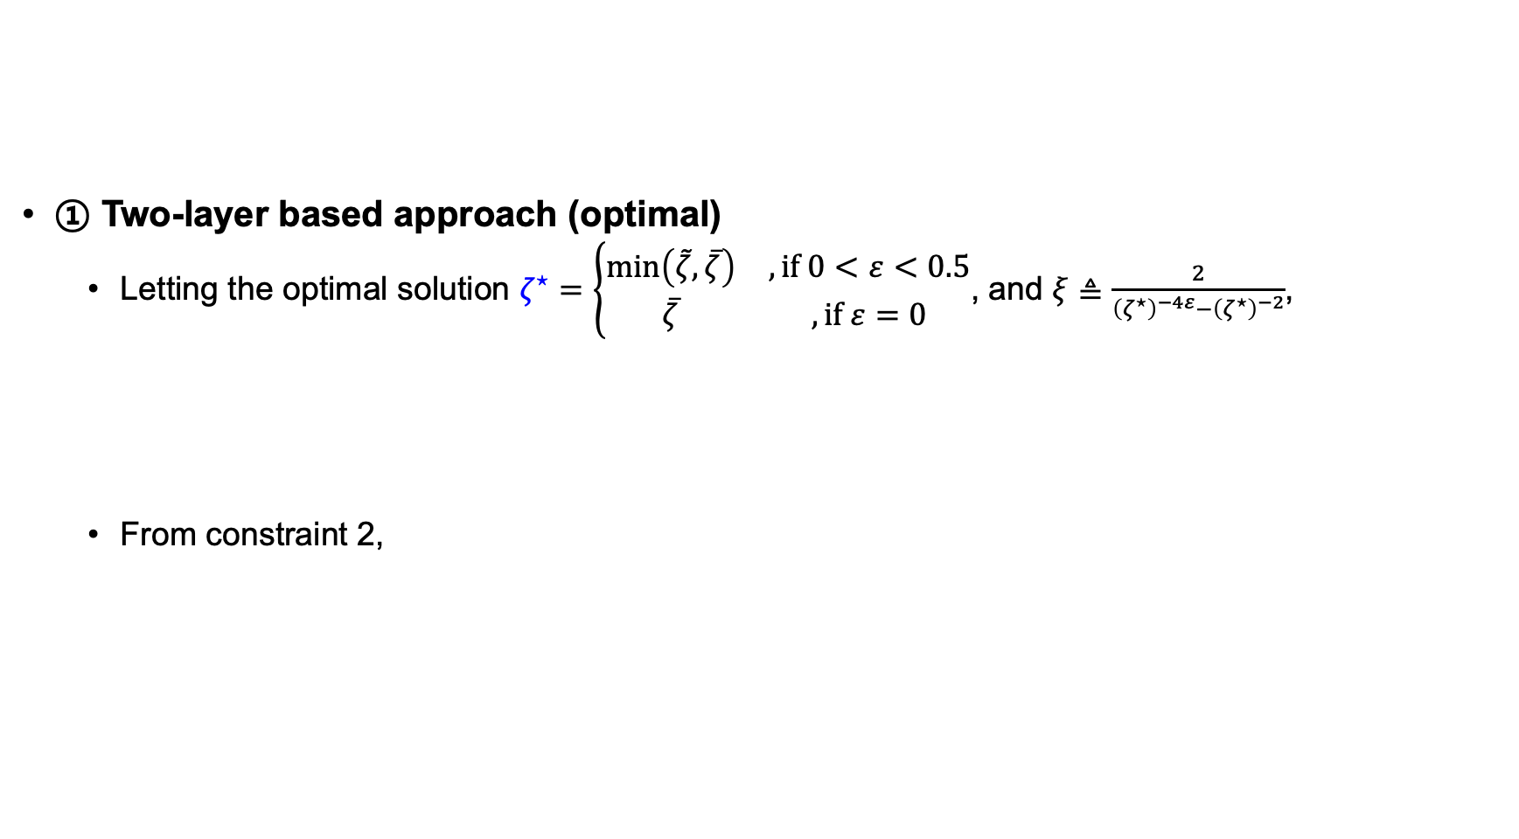
4. Proposed solutions
① Two-layer based approach (optimal)
Letting the optimal solution $ζ^{⋆}=\left\{\begin{matrix}\min\left(\tilde{ζ},\overline{ζ}\right) & , if 0<ε<0.5 \\ \overline{ζ} & , if ε=0\end{matrix}\right.$, and $ξ≜\frac{2}{{\left(ζ^{⋆}\right)}^{−4ε}−{\left(ζ^{⋆}\right)}^{−2}}$,
From constraint 2,

Slide 39
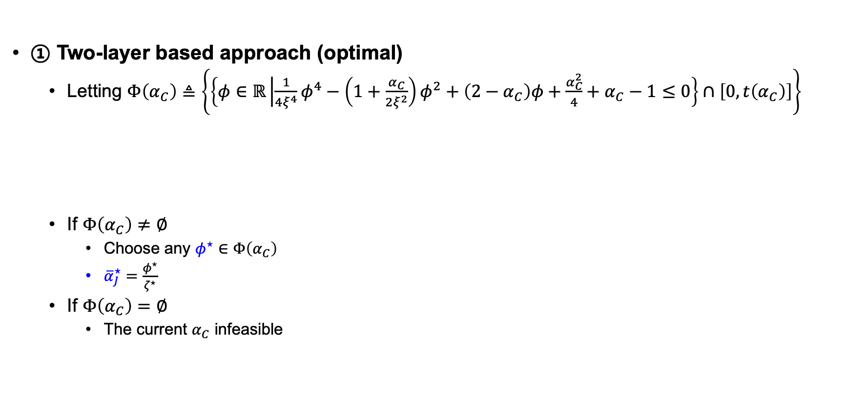
4. Proposed solutions
① Two-layer based approach (optimal)
Letting $Φ\left(α_{C}\right)≜\left\{\left\{φ∈ℝ\left|\frac{1}{4ξ^{4}}φ^{4}−\left(1+\frac{α_{C}}{2ξ^{2}}\right)φ^{2}+\left(2−α_{C}\right)φ+\frac{α_{C}^{2}}{4}+α_{C}−1≤0\right.\right\}∩\left[0,t\left(α_{C}\right)\right]\right\}$
If $Φ\left(α_{C}\right)≠∅$
Choose any $φ^{⋆}∈Φ\left(α_{C}\right)$
${\overline{α}}_{J}^{⋆}=\frac{φ^{⋆}}{ζ^{⋆}}$
If $Φ\left(α_{C}\right)=∅$
The current $α_{C}$ infeasible

Slide 40

4. Proposed solutions
① Two-layer based approach (optimal)
Algorithm summary
For $ε=0.5$

Slide 41

4. Proposed solutions
① Two-layer based approach (optimal)
Algorithm summary
For $0≤ε<0.5$

Slide 42
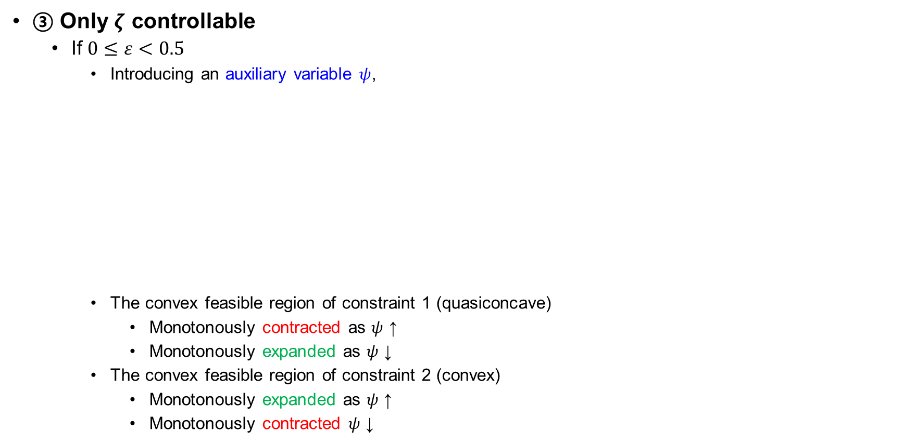
4. Proposed solutions
③ Only $ζ$ controllable
If $0≤ε<0.5$
Introducing an auxiliary variable $ψ$,
The convex feasible region of constraint 1 (quasiconcave)
Monotonously contracted as $ψ$ ↑
Monotonously expanded as $ψ$ ↓
The convex feasible region of constraint 2 (convex)
Monotonously expanded as $ψ$ ↑
Monotonously contracted $ψ$ ↓

Slide 43

4. Proposed solutions
③ Only $ζ$ controllable
If $0≤ε<0.5$
If $0.25≤ε<0.5$,

